Slide 1
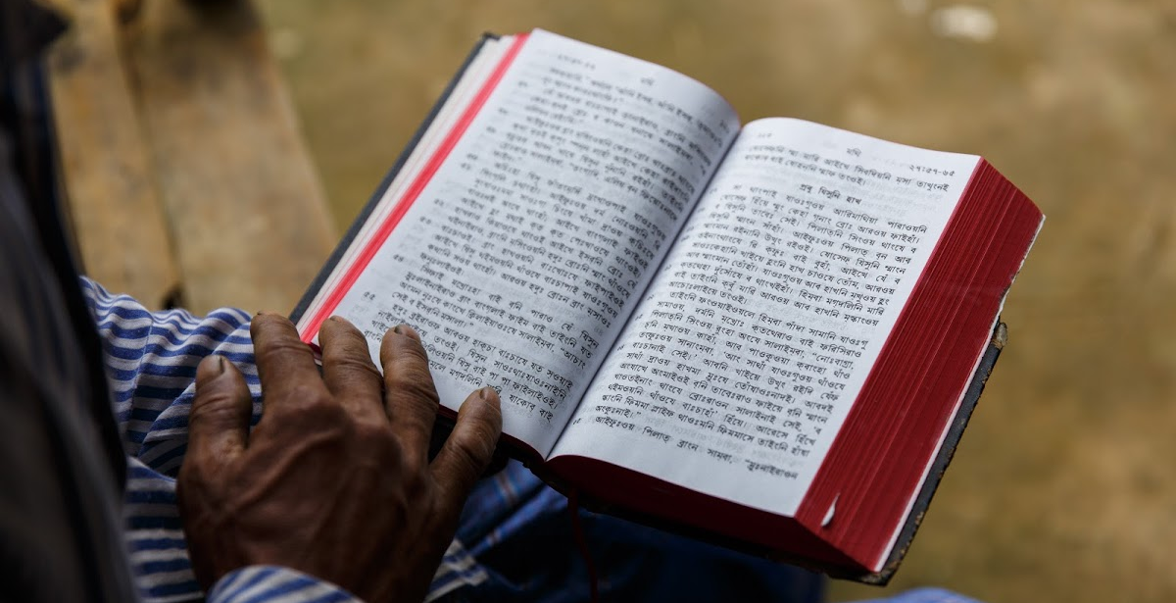
© Copyright

Slide 2
?
What do you know about copyright?

Slide 3
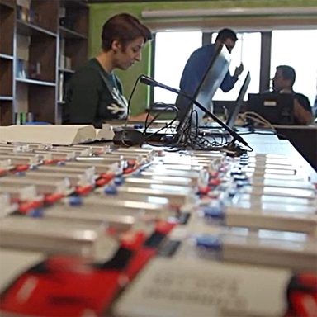
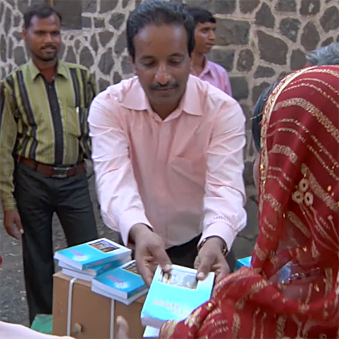
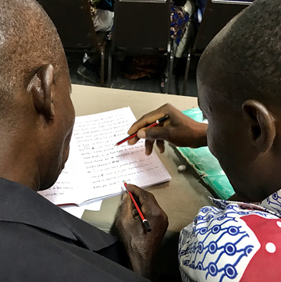
Rights granted to copyright owner
Make copies
Distribute and sell copies
Make adaptations

Slide 4
“All Rights Reserved” – exclusive rights
Without additional permission, others cannot:
Make copies
Distribute and sell copies
Make adaptations
Getting permission can be a lengthy and costly process.

Slide 5


Slide 6

Ability to give permission before being asked
Rights to copy, distribute, adapt, and perform

Slide 7

Attribution
This license allows reusers to distribute, remix, adapt, and build upon the material in any medium or format, if attribution is given to the creator.

Slide 8

Share Alike
Anything based on the original must use the same kind of license for the new work.
Slides adapted from https://docs.google.com/presentation/d/1xRsF5LrTSGzrQ6o4fW9xemthraKJ4IKLpfNBaDh5QkA/edit#slide=id.p and https://creativecommons.org/ site.

Slide 9
?
How is CC BY-SA copyright different from these traditional exclusive rights?
2 Corinthians 9:7

Slide 10



With CC BY-SA license
© permission is granted in advance to:
Make copies
Distribute and sell copies
Make adaptations
You Must:
Give attribution. Share alike.

Slide 11
?
Why do you think that WA does it differently?

Slide 12


